Slide 1

PREDICTING THE CRITICAL HOT SPOTS OF CRIMINAL ACTIVITY USING MACHINE LEARNING WITH PYTHON
By
Jai Chaudhrani
VP21CSCI0200072
M.Sc. Data Science
Under the Guidance of
Dr. G. Babu Rao
Assistant Professor
Dept. of Computer Science
GITAM ( Deemed to be University)

Slide 2
INTRODUCTION
BACKGROUND
AIM
EXISTING SYSTEM
PROPOSED SYSTEM
OBJECTIVES
SYSTEM REQUIREMENTS
MODULES
UML DIAGRAMS
SYSTEM DESIGN
TEST CASES
OUTPUT
CONCLUSION
CONTENTS

Slide 3
INTRODUCTION
Crime is one of the biggest social problems in today’s world and it is increasing at the fire pace which is a major cause for concern, hence there is a need to monitor and keep track of all the crimes so that it can be used by police department to investigate the cases easily and quickly.
With the increase of crimes, law enforcement agencies are continuing to demand advanced geographic information systems and new data mining approaches to improve crime analytics and better protect their communities.
By processing criminal data, law enforcement agencies can use models that may be important in the crime prevention process.
By providing a data mining approach to determine the most criminal hotspots and find the type, location and time of committed crimes, there’s a hope to raise people’s awareness regarding the dangerous locations in certain time periods.

Slide 4
BACKGROUND
In the modern United States history, crime rates increased after World War II, peaking from the 1970s to the early 1990s.
Violent crime nearly quadrupled between 1960 and its peak in 1991.
Property crime more than doubled over the same period.
Since the 1990s, however, crime in the United States has declined steadily.
Until recently crime prevention was studied based on strict behavioural and social methods, but the recent developments in Data Analysis have allowed a more quantitative approach in the subject.
The dataset of nearly 12 years of crime reports from across all of San Francisco's neighbourhoods is explored, and a model that predicts the category of crime that occurred, given the time and location is created.

Slide 5
AIM
To create a model which involves systematic analysis for predicting surges and hotspots of crime, and understanding patterns of criminal behavior that could help in solving criminal investigations.

Slide 6
EXISTING SYSTEM
Many researchers have gone through the problem regarding the criminal cases being unsolved for a long period.
They proposed different crime prediction algorithms.
In all these models the accuracy will surely vary depending on the data set and the features or attributes we select during data pre-processing because it is discovered that many machine learning algorithms are implemented on data sets consisting of different places having distinctive features, so predictions are changing in all cases.
Drawbacks:
By this methodology they had less accuracy in prediction.
By this methodology the results are not perfect.

Slide 7
PROPOSED SYSTEM
The proposed solution can potentially help people to stay away from the locations (crime hotspot) at a certain time of the day along with saving lives.
The police forces can use this solution to increase the level of crime prediction and prevention for police resources allocation.
It can help in the distribution of police at most likely crime places for any given time, to grant an efficient usage of police resources.
By having all of this information available, it will help to make our community safer for the people living there and also for others who will travel there.
Advantages:
A high accuracy prediction and better performance model is proposed.
The results are perfect and accurate.

Slide 8
OBJECTIVES
To find spatial and temporal criminal hotspots.
Forecast crime using a set of real-world datasets of crimes.
To locate the most likely crime locations and their frequent occurrence time.
To predict what type of crime might occur next in a specific location within a particular time.
To provide an analysis study by combining our findings of a particular crimes dataset with its demographics information.

Slide 9
Hardware Requirements
Processor: Intel dual core, i3 or higher
Speed: 2.2 GHz
RAM: 4 GB or higher
Hard Disk: 20 GB or higher
Software Requirements
Operating System: Windows 8 or higher
Programming Language: Python
IDE: Kaggle Notebook or Jupyter Notebook
SYSTEM REQUIREMENTS

Slide 10
Crime Data Preprocessing
Crime History Analysis
Data EDA
Implementation of the Model
Applying the LightGBM Algorithm
Prediction of Crime Hotspots
MODULES

Slide 11
MODULES
1. Crime Data Preprocessing
This module involves the data cleaning, filling the missing values and data transformation. It is used to reduce the complexity of the dataset and improve the performance of machine learning models by selecting only the most important features.
2. Crime History Analysis
This module involves analysis of the criminal activity happened in the past which will be helpful to understand the crime patterns and hotspots.
3. Data EDA
EDA (Exploratory Data Analysis) refers to the critical process of performing initial investigations on data so as to discover patterns, to spot anomalies, to test hypothesis and to check assumptions with the help of summary statistics and graphical representations.

Slide 12
MODULES
4. Implemention of the Model
The implementation of the model represents how a system (application, service, interface, etc.) works. This involves model fitting techniques and building process of LightGBM (Gradient Boosting Machine) model.
5. Applying the Light GBM Algorithm
LightGBM (Gradient Boosting Machine) is an ensembling algorithm which is used for faster training speed and higher efficiency. LightGBM (Gradient Boosting Machine) uses histogram based algorithm. It also replaces which continuous values to discrete bins result in lower memory usage.
6. Prediction of Crime Hotspots
Prediction of crime is a systematized method that classifies and examines the crime patterns.

Slide 13
UML DIAGRAMS
UML stands for Unified Modelling Language and is a standardized visual language used to represent and design software systems. UML diagrams provide a way to visually represent various aspects of a software system, including its structure, behaviour, and interactions.

Slide 14
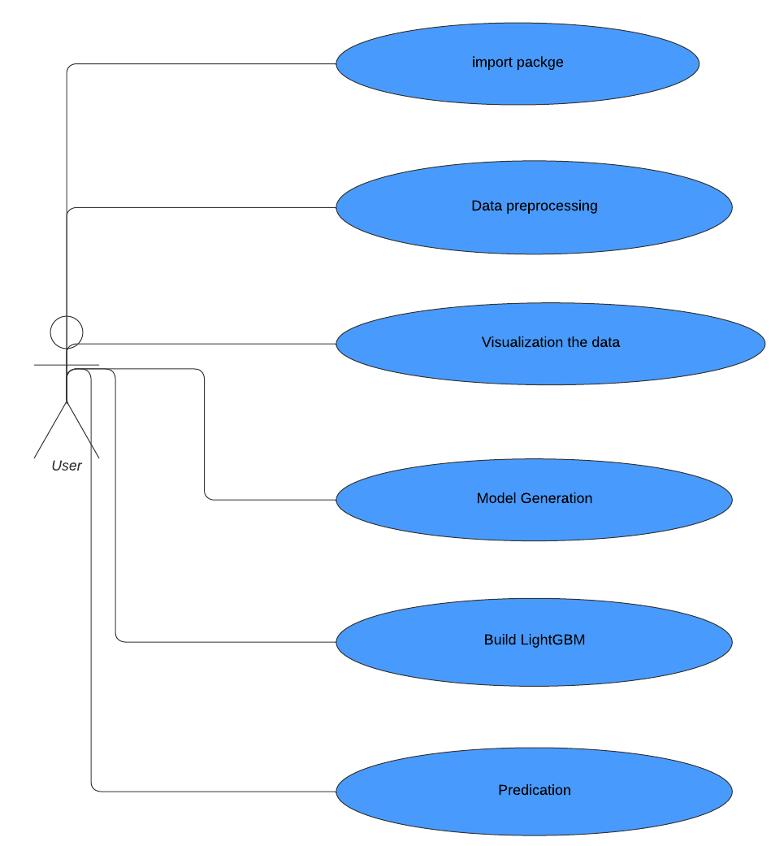
Use case DIAGRAM
Use case diagrams model behaviour within a system and help the developers understand what the user requires. A Use case of Criminal hotspot prediction analysis includes Importing the necessary packages, Data Cleaning or preprocessing, Visualization of the data, Generation of the model that is going to be used, Building the model and Prediction.

Slide 15
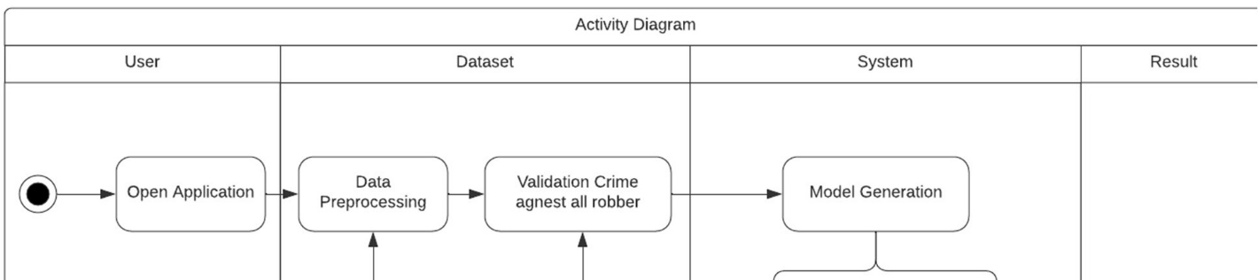
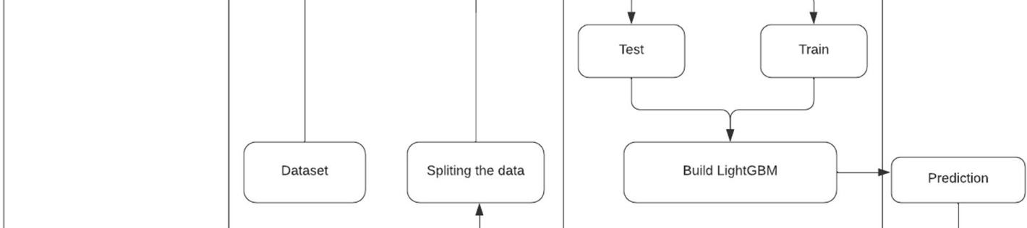
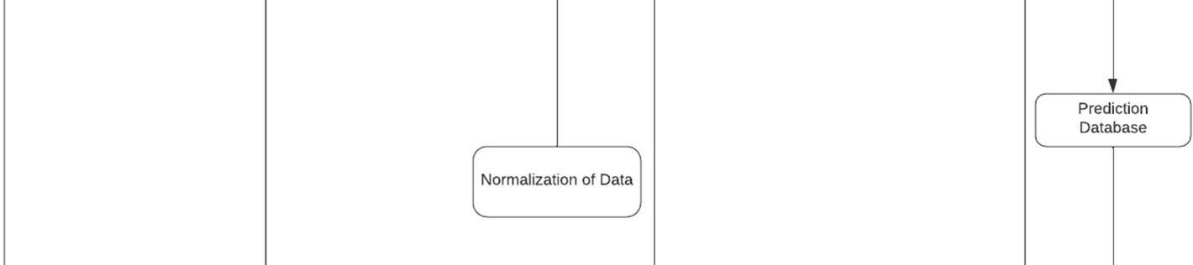
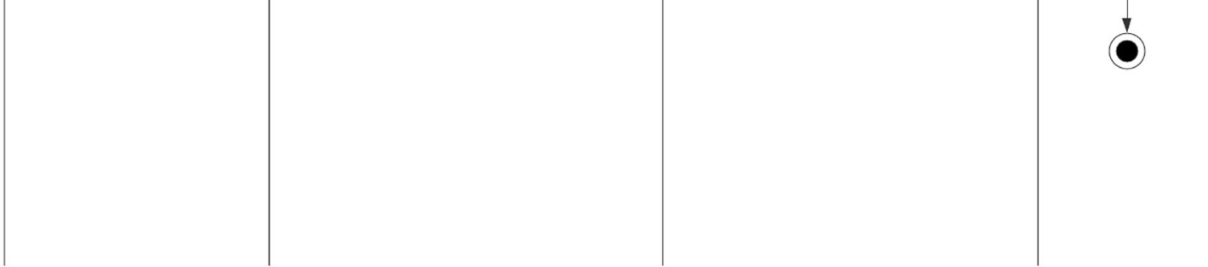
ACTIVITY DIAGRAM
An activity diagram for the Crime hotspot prediction project can help to illustrate the flow of activities involved in the model's functioning.

Slide 16
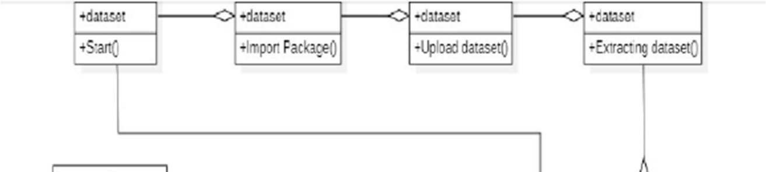
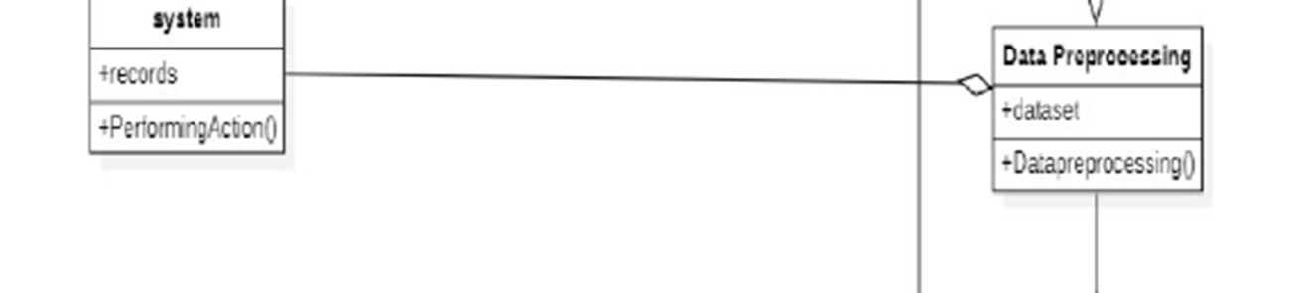
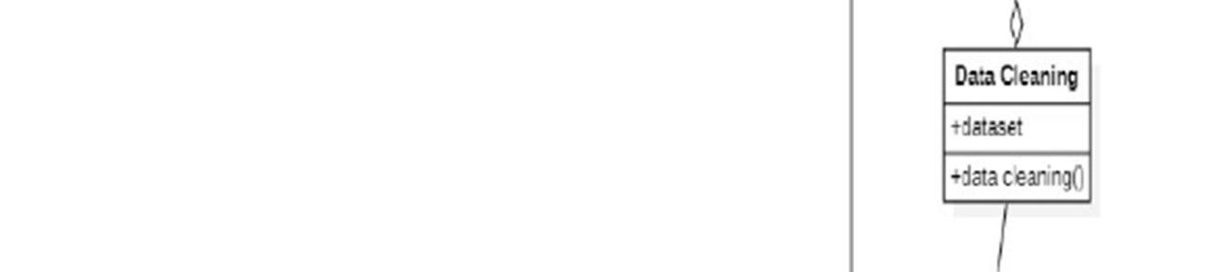
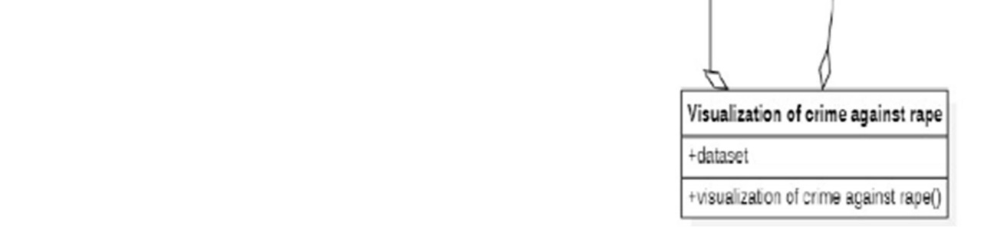
CLASS DIAGRAM
The class diagram for the Crime prediction project includes several classes that represent different modules and components of the prediction model. These classes are interconnected and work together to provide the model's functionality.

Slide 17
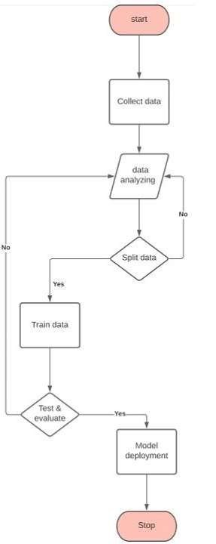
SYSTEM DESIGN
The design steps include the following:
Data Collection
Data Analysis and Visualization
Splitting of data
Training the data
Testing the data
Evaluating the data
Deploying the model
Fig: Data flow diagram

Slide 18
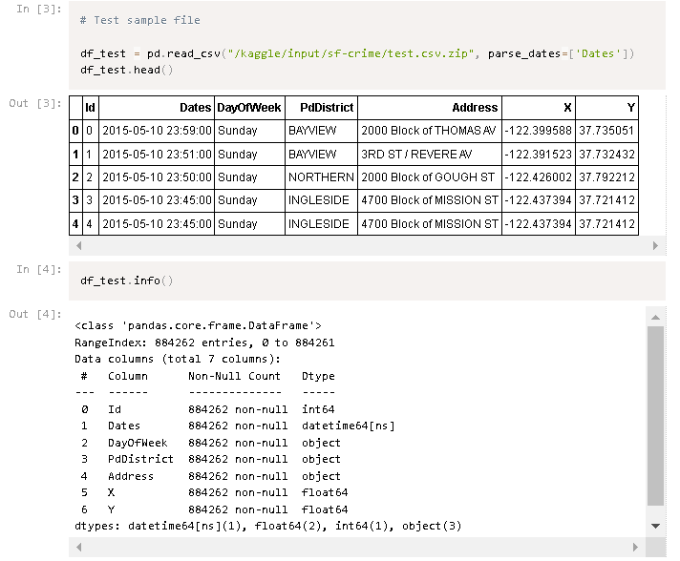
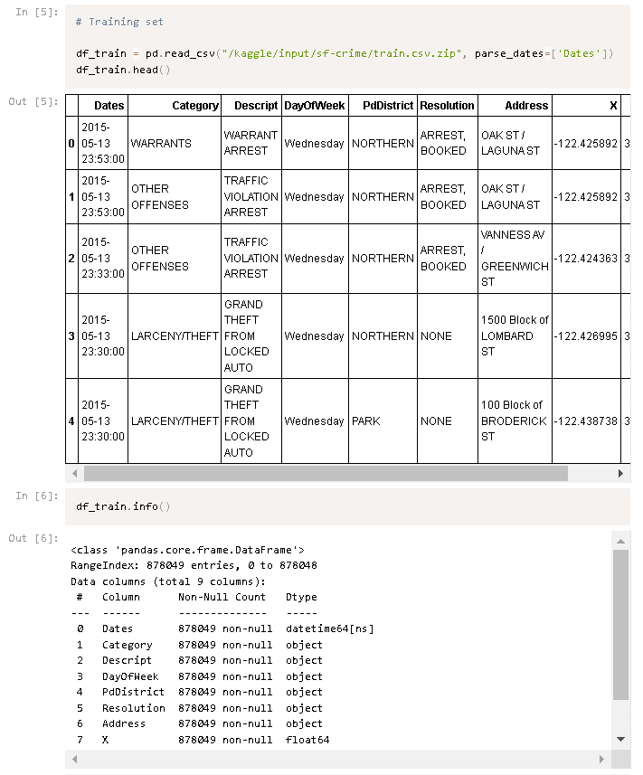
Data Collection:
For solving machine learning problems firstly, raw data is needed because without raw data machine learning problems cannot be solved.

Slide 19
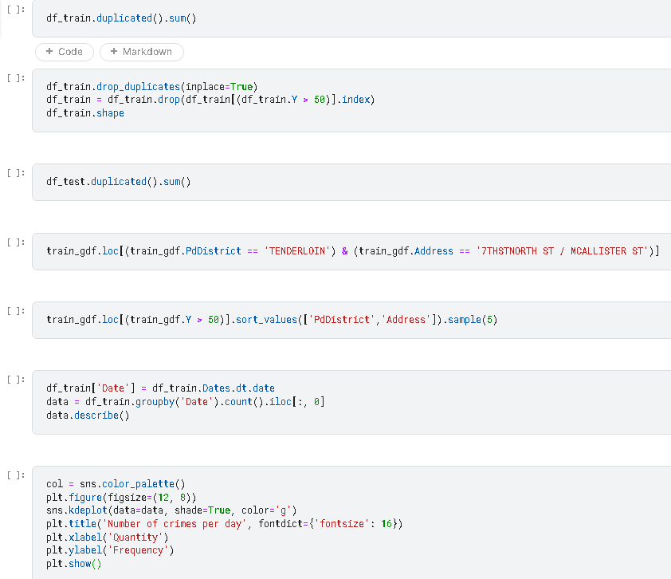
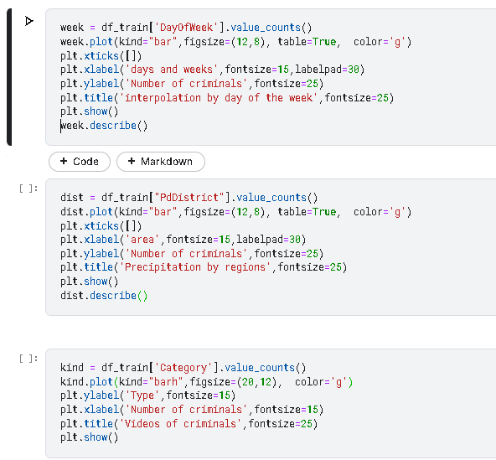
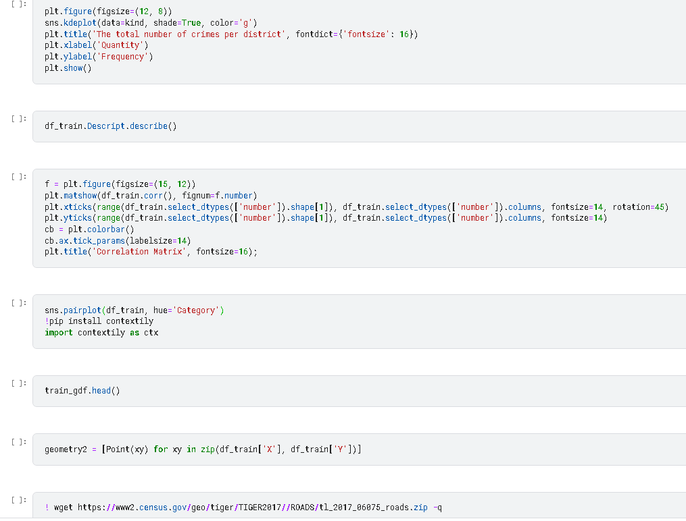
Data Analysis and Visualization:
After collecting data, the second step is data analysis which involves data cleaning. Data cleaning means either removing or using the imputer function for null values (if any). When working with data, it can be difficult to really understand the data if it is only in tabular form. To understand exactly what the data is telling us, to better organize the data and choose the right model, we need to visualize or image the data.

Slide 20
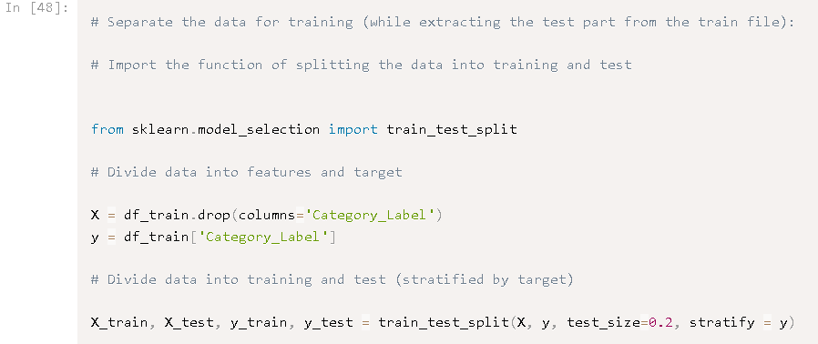
Splitting of data:
The next step is splitting of data in which data is split for training and testing. Almost 80% of data is for training and 20% for testing which is a basic rule in the machine learning.

Slide 21
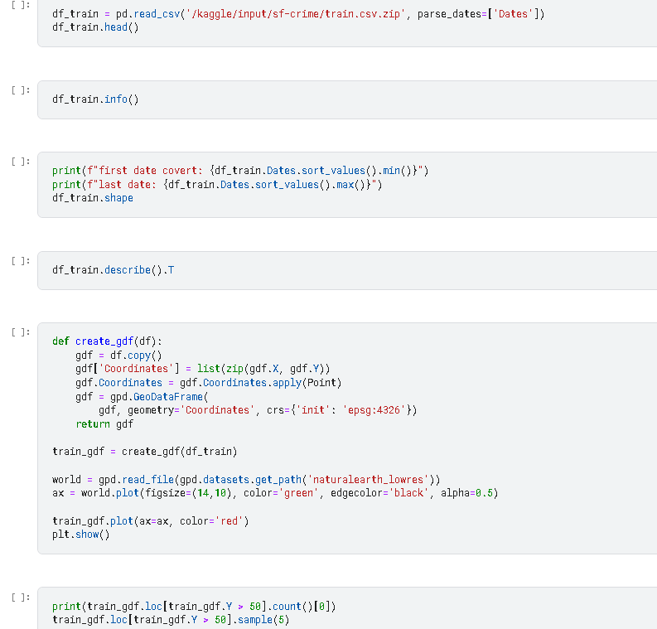
Training the data :
In this step, data is trained for machine analysis itself and one more step which is done is a validation of training data because training data set will generate either overfitting or under fitting problem that means false positive output or true negative output.

Slide 22
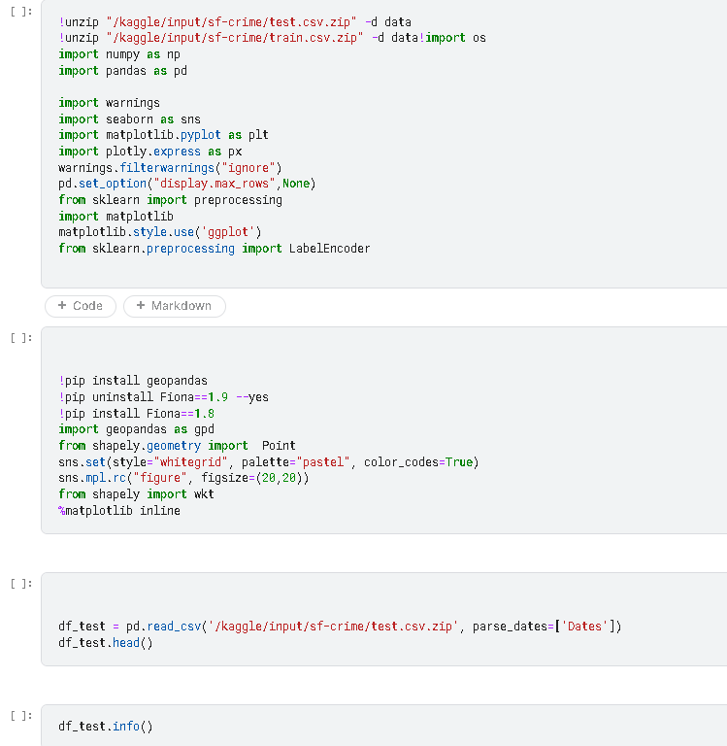
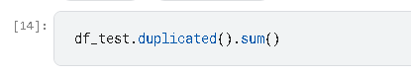
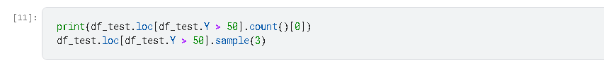
Testing the data:
In the testing phase, the model is tested using cross-validation. The model is checked to know if it is going is right or not. Some techniques of cross-validation and confusion matrix is used for checking model performance.

Slide 23
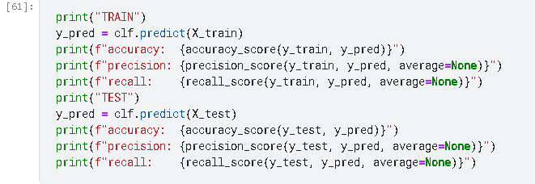
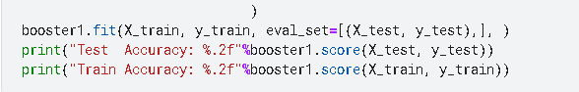
Evaluating the data:
The data is then evaluated and the results are shown.

Slide 24
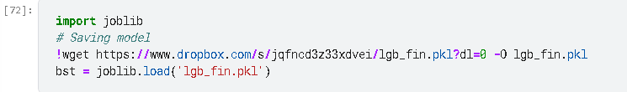
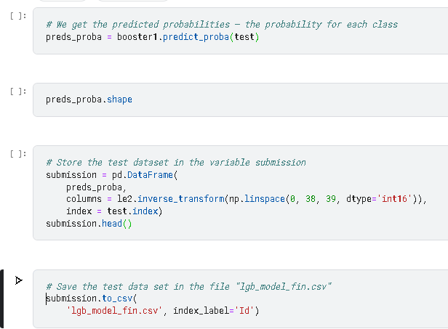
Deploying the model:
The last step is model deployment which means after saving the model either pickle file is used in web development or s/w. The final output will be a csv file showing each attribute’s accuracy.

Slide 25
TEST CASES
Test Case Description | Expected Outcome | Actual Outcome | Pass/Fail
Test loading dataset from file. | Loaded dataset matches original dataset file | Loaded dataset matches original dataset file | Pass
Test splitting dataset into training and testing sets | Training set and testing set have expected sizes | Training set and testing set have expected sizes | Pass
Test feature selection | Selected features have expected correlation with software defectiveness | Selected features have expected correlation with software defectiveness | Pass
Test algorithm training | Trained algorithm has expected accuracy, precision, recall, and F-measure on training set | Trained algorithm has expected accuracy, precision, recall, and F-measure on training set | Pass
Test algorithm testing | Tested algorithm has expected accuracy, precision, recall, and F-measure on testing set. | Tested algorithm has expected accuracy, precision, recall, and F-measure on testing set | Pass

Slide 26
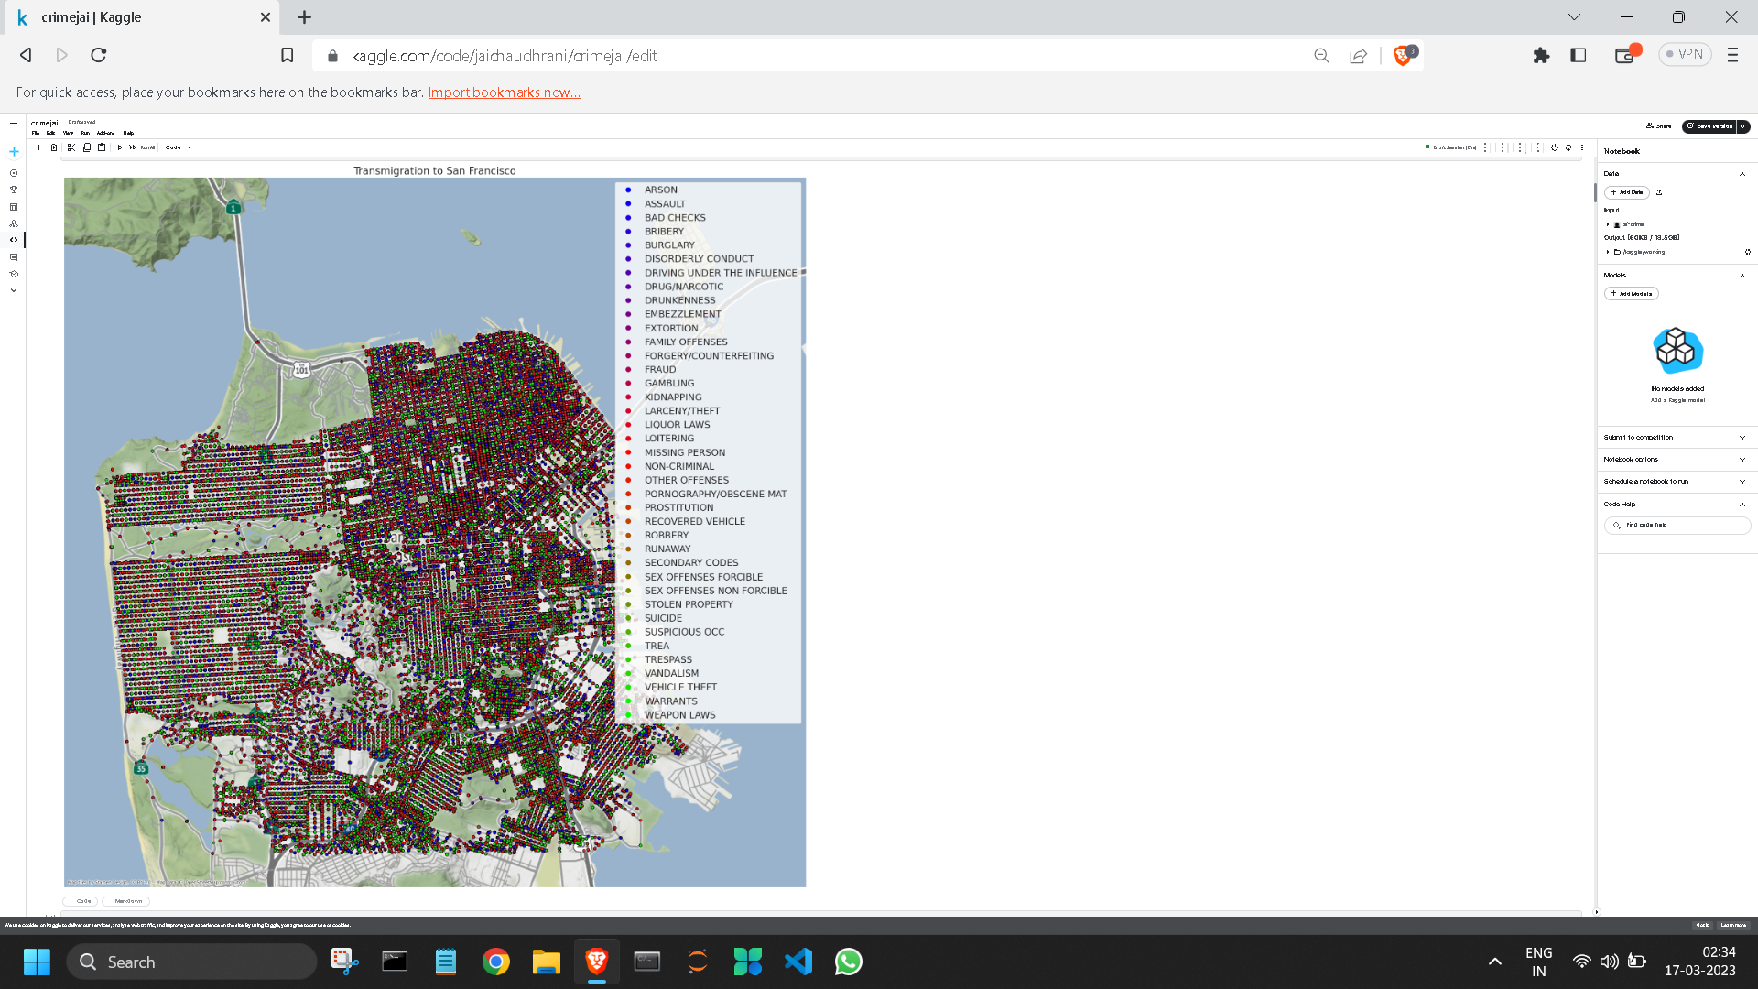
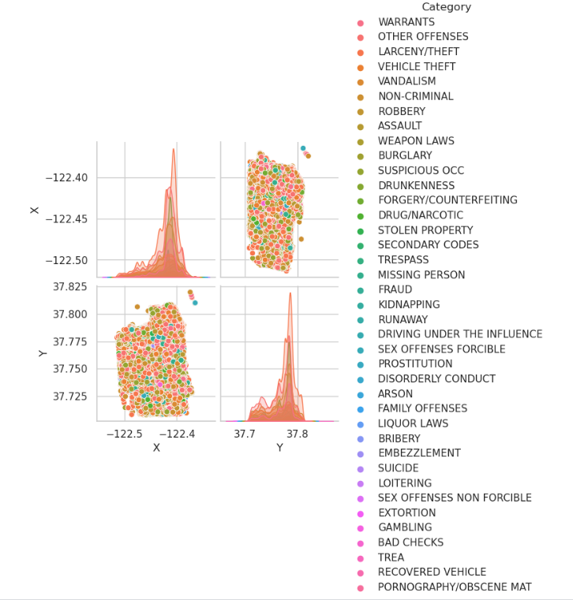
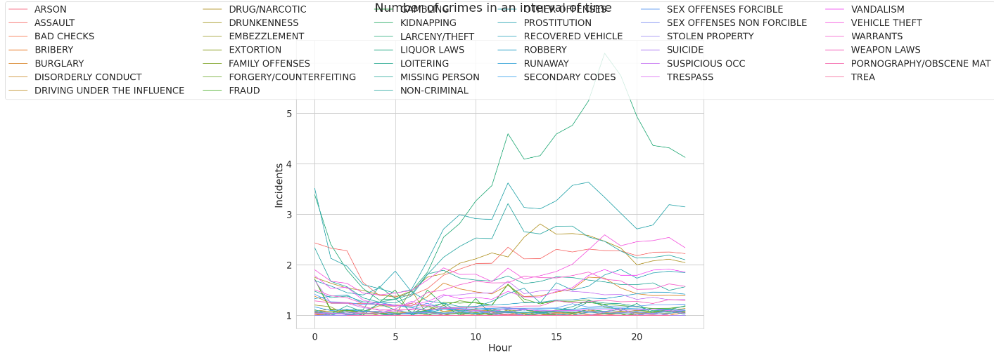
OUTPUT

Slide 27
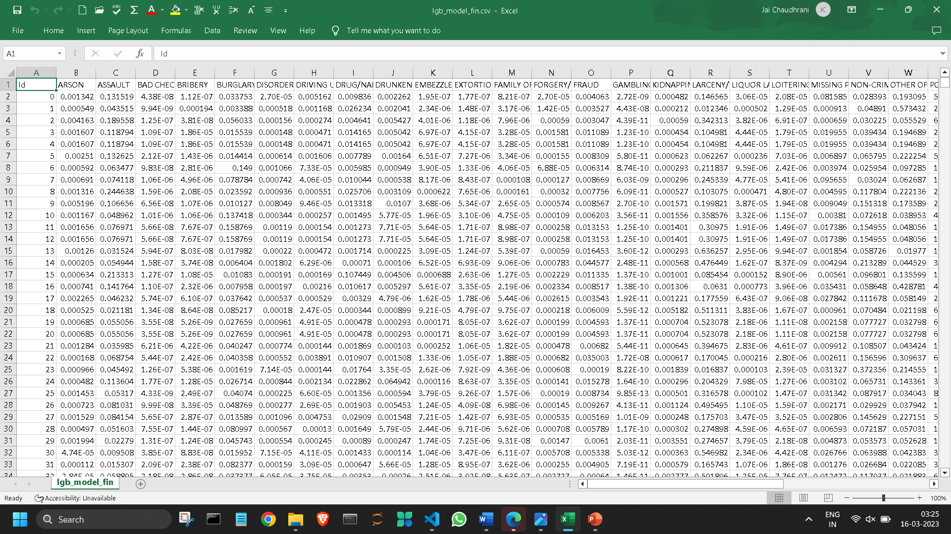
OUTPUT

Slide 28
CONCLUSION
From the encouraging results, it is believed that the crime prediction has a promising future for increasing the effectiveness and efficiency of criminal and intelligence analysis. Visual and intuitive criminal and intelligence investigation techniques can be developed for crime pattern.

Slide 29
THANK YOU

